Slide 1
Predicting Bike Replenishment on Bike Sharing Station
Using SF Bay Area bike sharing data
Shantanu Rathore

Slide 2
Objective
The objective, is to build a model which is able to accurately identify when a bike station will need bicycle replenishment so that potential customers do not run out of available bicycles during rush hour or otherwise
The model which predicts with the highest accuracy as well as the lowest false positive and false negative rates is chosen to accomplish our goal

Slide 3
Methodology
We begin by combining the data as the relevant information is present in a number of different data sets. These data sets are in form of time series data.
Our key data set contains dock information for every minute of the day. We begin by compressing this data to make our analysis easier to understand and for building faster models.
Features have then been build on the compressed time series data. The time series data is basically converted to a regular data set on which we can use classification techniques.

Slide 4
Assumptions and Limitations
Assumptions
There are many assumptions in this case:-
The forecasts for the bicycle traffic need to be fairly accurate. This is possible with the data available to us. More data can possibly make it more accurate to figure it out.
The dock sensors, which identify whether a bicycle has been taken out of the dock are fairly accurate, fast (sending data instantaneously) and reliable (low failure or error rates)
For our model building, I have assumed the minimum number of bicycles which trigger the flag as 4. This number can be changed though.
Limitations
Our target variable depends on forecasts. If an unseen event or change in traffic effects the forecast, our target variable also gets effected.
There is much more data which can be gathered regarding the docs and customers or subscribers. This can help in building a better model but is not available to us. For example, if we have subscriber data, we can forecast with great accuracy which subscribers are likely to take a bike and this helps in traffic prediction.

Slide 5
Data Set Description
The data set was obtained from the location : https://www.kaggle.com/benhamner/sf-bay-area-bike-share
The data set is large (660 MB) includes multiple tables
After feature building, we have worked on a data set which has 25 features and 300,000 rows of data
We have taken the help of pyspark to load, wrangle and clean the data
Pandas have been used for time series analysis and data compression as well as feature building

Slide 6
Models and Model Evaluation
kNN (k Nearest Neighbours)
Decision Tree Classification
Random Forests
Model Evaluation has been done on the basis of the following
Accuracy
Confusion Matrix
ROC Curve
Precision and recall

Slide 7
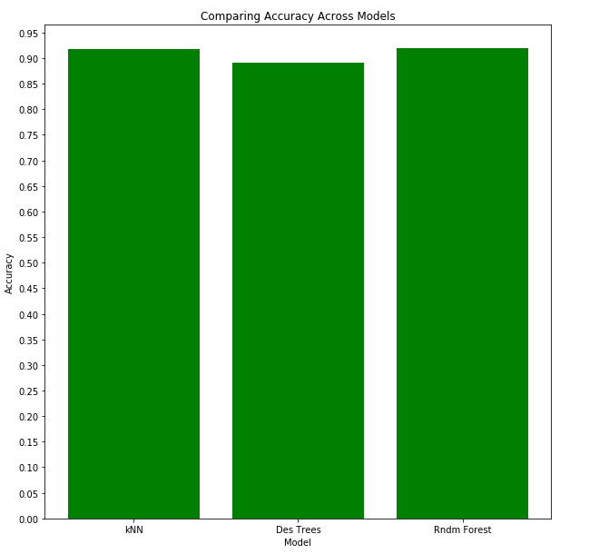
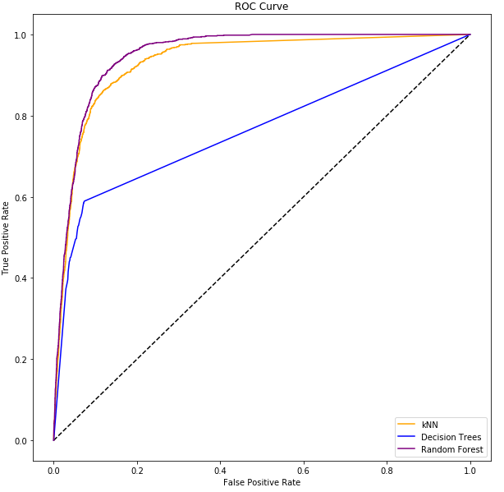
Results

Slide 8
Results and Conclusion
The model which uses Random Forest for prediction gives us the maximum revenue.
Minimizing the number of false positives and false negatives was important for us in this scenario, as we try to accurately predict when the station will require additional bicycles.
This will enable us to retain customers who may use services of other companies if they find the docking station does not have bikes.

